Slide 1
Personal Website
Moodboard + Concept + IA and Schedule

Slide 2
Concept
- Retro mood
- Art Collage
- Interactive
-time capsule

Slide 3
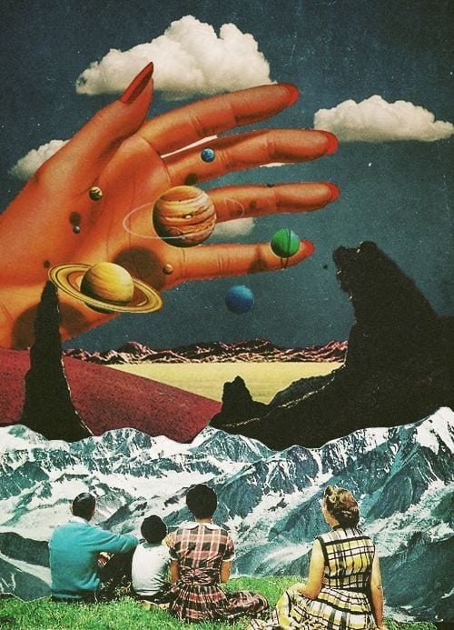


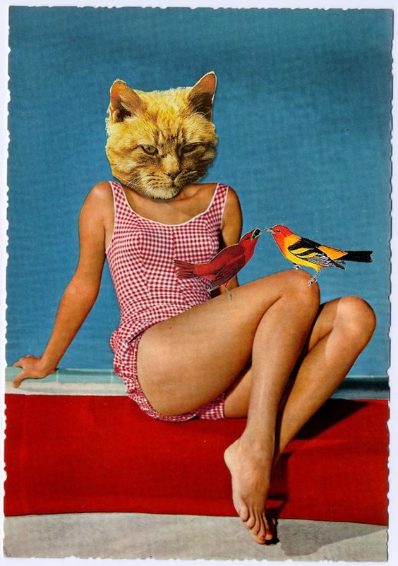

MoodBoard

Slide 4


Slide 5
IA 구성
홈 (no js)
좋아하는 영화 – interactive curtain (no js)
어렸을 때 좋아했던 장난감 – click => description (no js)
좋아하는 음악 – slider js (jQuery)
죽기전에 하고 싶은 3가지 – tarot card carousel (jQuery)
Contact me (no js)

Slide 6
Scheduling
Mon | Tues | Wed | Thurs | Fri | Sat | Sun
 |  |  |  | 06 초기 와이어 프레임 구상 | 07 와이어 프레임 구상 cont. | 08 와이어 프레임 완성
09 Prototype 코딩 (movie page) | 10 Prototype 코딩 끝 | 11 Toy page code start | 12 Toy page code cont. | 13 Feedback and edit | 14 Music page coding | 15 Death page coding
16 Music page coding | 17 Death page coding cont. | 18 Contact page coding | 19 Contact page cont. | 20 Feedback and edit | 21 Final edit | 22 Finish coding
23 Upload site | 24 Upload site | 25 Upload site | 26 Upload site | 27 D-Day

